Slide 1
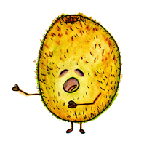
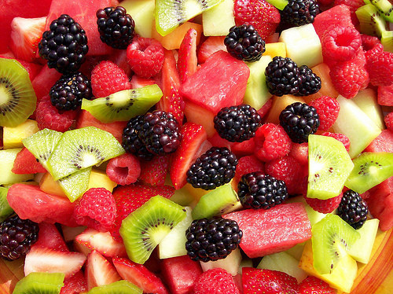
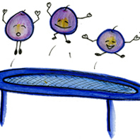
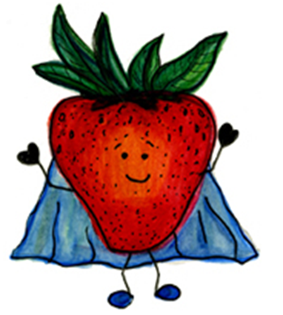
Serving size for 1500 calorie/day plan
Calories in this snack: 89
Preparation Key: *kids-can-help **parents
Kiwi, Strawberries, and Blueberries
INGREDIENTS
1 Kiwi, peeled and sliced
¾ cup Strawberries
2 Tbl Blueberries
PREPARATION
*Mix the kiwi, blueberries, and strawberries together in a bowl and enjoy!
Having fruits as a snack is a great way to satisfy your sweet tooth and also get plenty of vitamins and minerals into your body. They have natural sugars which are healthier than added sugars from processed foods. What other fruits do you like to eat as a snack?
Did you know that blueberries are one of the only natural foods that are truly blue?
Copyright ©2015 Fit4Kidz.us |All Rights Reserved | www.fit4kidz.us

