Slide 1
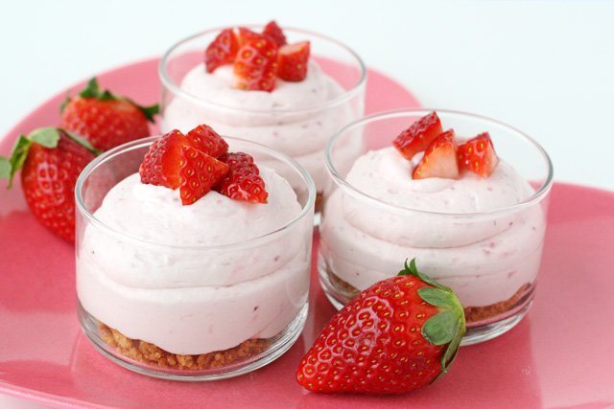
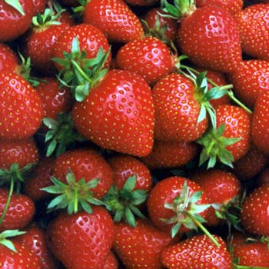
Serving size for 1500 calorie/day plan
Calories in this snack: 87
Preparation Key: *kids-can-help **parents
Graham Cracker Delight
INGREDIENTS
2 Graham cracker squares
2 Tbl Whipped cream
¼ cup Strawberries, sliced
PREPARATION
*Cover graham crackers with whipped cream.
*Top with sliced strawberries.
Strawberries are a great snack! They are packed with vitamin C! They also have vitamin A, vitamin E, vitamin B-6, niacin, folic acid, and riboflavin! What other berries do you like on top of whipped cream?
Did you know that strawberries are the only fruit with seeds on the outside?
Copyright ©2015 Fit4Kidz.us |All Rights Reserved | www.fit4kidz.us

