Slide 1
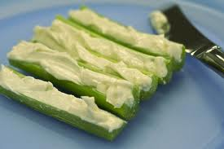
Serving Size for 150/ Calorie/Day Plan
Calories in this Meal: 120
Preparation Key: *Kids **Parents
Celery and Cream Cheese
INGREDIENTS
Celery- 5 strips
Light Cream Cheese – 3 Tbl
PREPARATION
** Cut celery to desired length
* Spread on cream cheese
Enjoy!
Did you know that…
…Celery is an excellent source of fiber, magnesium, and can help your immune system as well, so you won’t get sick as much!
Copyright ©2015 Fit4Kidz.us |All Rights Reserved | www.fit4kidz.us

