Slide 1
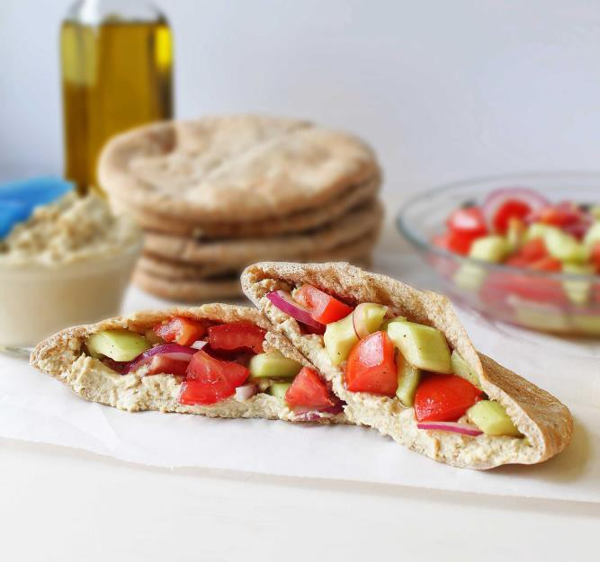


Serving Size for 1500 calorie/day plan
Calories in this meal: 383
Stuffed Pita
Preparation Key:
*Kids can help **parents needed
INGREDIENTS
1 Whole wheat pita bread (8 inches)
¼ cup Hummus
¼ Cucumber
½ Tomato
4 Celery sticks
1 Tbl Reduced Fat Ranch 1 Serving Fruit
PREPARATION
**Slice cucumber and tomato.
http://simplyfreshcooking.com/wp- content/uploads/2012/05/Mediterranean-Pita2.jpg
*Stuff pita bread with hummus, cucumber and tomato.
*Enjoy with celery and ranch and a serving of fruit.
“Pita” is based off a Greek word, first introduced in 1936. Pita bread is made by baking it at very high temperatures, so it ”puffs up” and then deflates when it is removed from the oven, causing a large bubble form in the middle. Then when you slice it in half, there’s a pocket!
Copyright ©2015 Fit4Kidz.us |All Rights Reserved | www.fit4kidz.us

