Slide 1
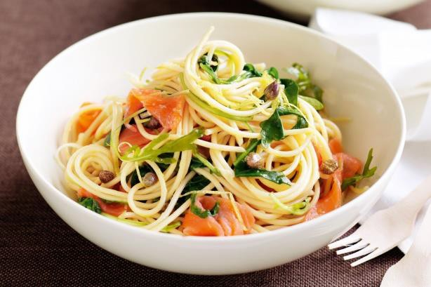
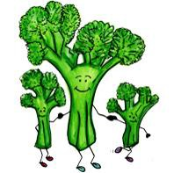
Serving Size for 1500 calories/day plan Total Calories in this Meal: 514
Preparation Key: *Kids **Parents
Sensational Salmon & Spaghetti
INGREDIENTS
2 ¼ oz. spaghetti 1 cup water
1 tsp lemon peel 1 carrot
1 cup broccoli
1 spring onion
½ tomato
4 oz. salmon
1 garlic clove
PREPARATION
**Prepare spaghetti noodles according to package direction until "al dente".
**Bring 1 cup water, 1 tsp. grated lemon peel and small garlic clove (peeled) to simmer.
*Add carrots (finely sliced), broccoli (cut into small florets), onions and tomatoes, and simmer for 1 minute.
*Add the spaghetti noodles.
**Set salmon fillet (raw) on vegetables in pan.
**Cover and steam salmon, surrounded with vegetables and cooking broth.
**Steam 5-6 minutes until salmon is pink and flakes easily. Garnish with spring onion tops.
Wild salmon has high quality protein- which all kids need to grow big and tall! It also contains Omega-3 fatty acids that are good for your brain development and heart health!
Copyright ©2015 Fit4Kidz.us |All Rights Reserved | www.fit4kidz.us

