Slide 1
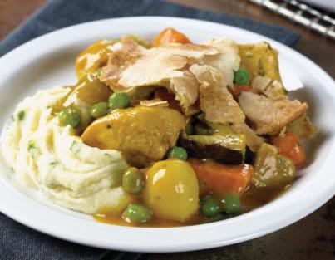
Serving Size for 1500 calories/day plan Total Calories in this Meal: 517
Preparation Key: *Kids **Parents
Pot Pie
INGREDIENTS
Potatoes - 7 ½ oz
Skim milk - 1 ½ Tbl Broccoli - 1 ½ cups
Spinach leaves - 1 1/8 cups Vegetable oil - 1 1/8 tsp Onion - 1/3 cup
PREPARATION
Green bell pepper - 1/3 Carrot - 1 ½
Stewed tomatoes - 6 Tbl Tomato paste - 2 ¼ tsp Basil
Thyme
**Steam raw potatoes (cut into chunks) in water until soft. *Mash and add 1/2 teaspoon salt and milk.
**Cut broccoli into florets and stems and steam until soft. (Best to steam with potatoes if you have a large enough pot.)
*Wash and dry bunch spinach (or dark green of choice) thoroughly, and **chop into bite-size pieces.
*Pre-heat oven to 350 degrees.
**Saute' onion in oil. Add broccoli, green pepper (sliced), carrots (cut into small parts),½ teaspoon basil and 1/4 teaspoon thyme.
*Stir well and add tomatoes (fresh or canned) and tomato paste.
**Bring to boil, cover and simmer on low heat until vegetables are tender.
*Stir in spinach and 1 teaspoon salt.
*Place vegetables in baking dish. Spread potatoes over top and shake paprika over all.
**Bake for 12-15 minutes or until potatoes are hot
Potatoes are a type of starchy vegetable.
Potatoes are rich in carbohydrates- our meal today has 126g of carbohydrates. Does that seem like a lot? Our diet should be 45-65% carbohydrates.
Copyright ©2015 Fit4Kidz.us |All Rights Reserved | www.fit4kidz.us

