Slide 1
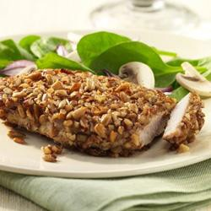



Serving Size for 1500 calories/day plan Total Calories in this Meal: 531
Preparation Key: *Kids **Parents
Pecan Pork Chops
INGREDIENTS
Lean pork tenderloin - 3 ¾ oz
Skim milk - 1 Tbl Dijon mustard - 2 tsp Pecans - 4 tsp
Bread crumbs - 1 Tbl Vegetable cooking spray - 1
Spanish rice - 4 Tbl Light spread - 1 tsp Whole tomatoes - ¼ cup Garlic Pepper
Garlic Powder
PREPARATION
**Remove any remaining fat from pork tenderloin.
*In a shallow bowl, mix skim milk with Dijon-style mustard.
*In a second shallow bowl, mix bread crumbs, pecans, 1/8 tsp garlic powder, and ½ tsp garlic pepper.
*Dip pork into milk mixture, coating both sides and then roll in bread crumb mixture.
*Continue dip and roll procedure until pork is thoroughly covered.
**Treat a small, non-stick skillet with vegetable cooking spray. Cook pork over low heat about 10 minutes.
**Turn pork over and cook an additional 10 minutes, or until pork is fully cooked and both sides are golden
brown.
**While pork is cooking, prepare rice according to package instructions.
**Drain and chop tomatoes and add to rice.
Pecans are the number one nut when it comes to antioxidant levels. Pecans contain more than 19 vitamins and minerals – including vitamin A, vitamin E, folic acid, calcium, magnesium, phosphorus, potassium, several B vitamins and zinc.
Copyright ©2015 Fit4Kidz.us |All Rights Reserved | www.fit4kidz.us

