Slide 1
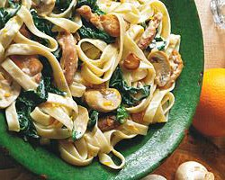

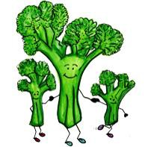

Serving Size for 1500 calories/day plan Total Calories in this Meal: 529
Preparation Key: *Kids **Parents
Orangie Chicken and Pasta
INGREDIENTS
Skinned chicken breast - 3 ¼ oz
Fettuccine - 1 ¼ oz Orange Juice - 2 Tbl Spring onion - 1 Bacon bits - 1 tsp Cornstarch - ½ tsp Light spread - 1 tsp
Grated Parmesan cheese - 2 tsp Vegetable cooking spray - 1 Broccoli - 1 cup
Orange Peel Garlic
Salt
Pepper
PREPARATION
**Cook fettuccini according to package instructions. After draining, stir in margarine.
**Preheat oven broiler.
**Broil chicken in a pan treated with vegetable cooking spray for 10 minutes, turning once after 5 minutes.
*Mix 1/4 cup water, orange juice, 1 teaspoon orange peel (or finely grated fresh orange peel), onion, pinch of
salt, 1/8 teaspoon pepper, 1 minced garlic clove, and cornstarch in a small sauce pan and **heat over medium heat, stirring constantly (approximately 5 minutes) until mixture thickens.
*Serve chicken on bed of fettuccini and top with orange sauce, parmesan cheese and bacon bits.
This is a high protein meal- 45 grams! Protein is found in all forms of meat, beans and nuts.
Protein is essential for building up tissues in your body.
Copyright ©2015 Fit4Kidz.us |All Rights Reserved | www.fit4kidz.us

