Slide 1
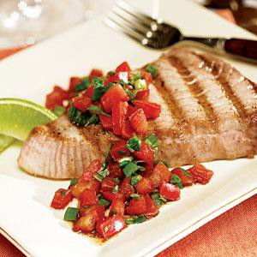
Serving Size for 1500 calories/day plan Total Calories in this Meal: 531
Preparation Key: *Kids **Parents
Grilled Tuna Steak with Salsa
INGREDIENTS
4 oz. Tuna Steak 1 cup Salsa Vegetable Spray
2 ½ cups of zucchini, steamed
1 Whole Wheat Roll 1 cup Skim Milk
Dinner Salad with Dressing Garlic Powder to Taste
PREPARATION
**Coat both sides of the Tuna Steak with cooking spray, and sprinkle with garlic seasoning.
**Grill until cooked through on both sides (a piece of fish should cook in no longer than 10 minutes).
*Cover Tuna Steak with salsa and serve.
*Spray cooking spray on a nonstick skillet and add chopped zucchini.
*Add a sprinkle of garlic powder if desired.
**Cook about four minutes or until tender.
Did you know that Bluefin tuna can grow up to three meters long and swim as fast as 43 mph?
Tuna makes up a third of all the seafood Americans eat,
especially canned tuna.
Copyright ©2015 Fit4Kidz.us |All Rights Reserved | www.fit4kidz.us

