Slide 1
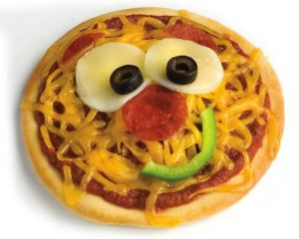
Serving size for 1500 calorie/day diet
Calories in this meal: 515
Preparation Key: *kids can help **parents
Fun Pizza Faces
INGREDIENTS
Pizza Crust, 6 inch- 1 1 garlic clove
Pizza sauce- ½ cup Oregano
Onion- ¼ cup Black Pepper
Mushrooms- ¼ cup Grated Parmesan cheese- 1 tsp
Green bell pepper- ¼ cup Part-skim mozzarella cheese- 4 Tbl
Broccoli- ¼ cup
PREPARATION
**Chop onion, mushrooms, green pepper, broccoli, and 1 garlic clove and set aside.
*Place pizza shell on cookie sheet or pizza pan.
*Top with pizza sauce.
*Distribute vegetables and garlic over sauce making ears, eyes, nose, and a mouth
to form a face. Sprinkle with oregano and pepper.
*Spread cheeses over top to make hair.
**Bake in oven according to pizza shell directions or until cheese is melted and crust is golden brown.
To make this pizza healthier, choose whole wheat pizza crust and serve with a dinner salad! If you want to add meat, try boneless, skinless chicken breast and turkey pepperoni.
Did you know that 94% of Americans eat pizza regularly?
Copyright ©2015 Fit4Kidz.us |All Rights Reserved | www.fit4kidz.us

