Slide 1
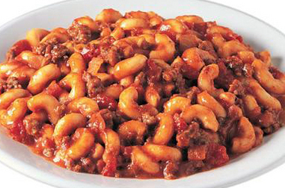
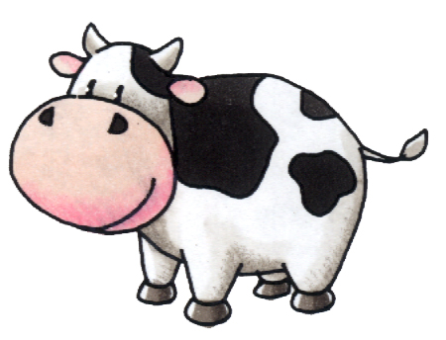
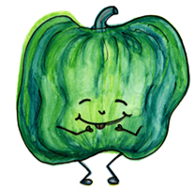
Serving Size for 1500 calorie/day diet
Calories in meal: 524
Preparation Key: *kids can help **parents
Beefy Mac n’ Cheese
INGREDIENTS
Lean ground round beef- 3 ¼ oz Oregano- 1 tsp
Macaroni- 1/3 cup Basil- 1 tsp
Spring onion- 1 Vegetable cooking spray
Green bell pepper- ¼ Yellow squash- ½ cup
Celery- 1 Dinner salad, w/ dressing- 1
Stewed Italian Tomatoes- ½ cup
Grated Parmesan cheese- 1 tsp
PREPARATION
**Cook macaroni according to package instructions.
**Spray medium sized, non-stick skillet with vegetable cooking spray. Over medium heat, sauté onion, green pepper, and celery until tender-crisp.
*Add ground beef and cook until meat is browned, stirring occasionally. Drain meat.
*Add tomatoes, undrained, and cut into bite sized pieces, ¼ tsp oregano, ¼ tsp basil, and parmesan cheese. Mix well.
*Finally, add cooked macaroni, mix well, and heat thoroughly before serving.
Serve with yellow squash and dinner salad.
This meal provides a lot variety! Choosing lean ground beef is a great way to get your protein and iron while staying low in fat. This meal also has loads of vegetables and when cooked into dishes can be much tastier!
Copyright ©2015 Fit4Kidz.us |All Rights Reserved | www.fit4kidz.us

