Slide 1
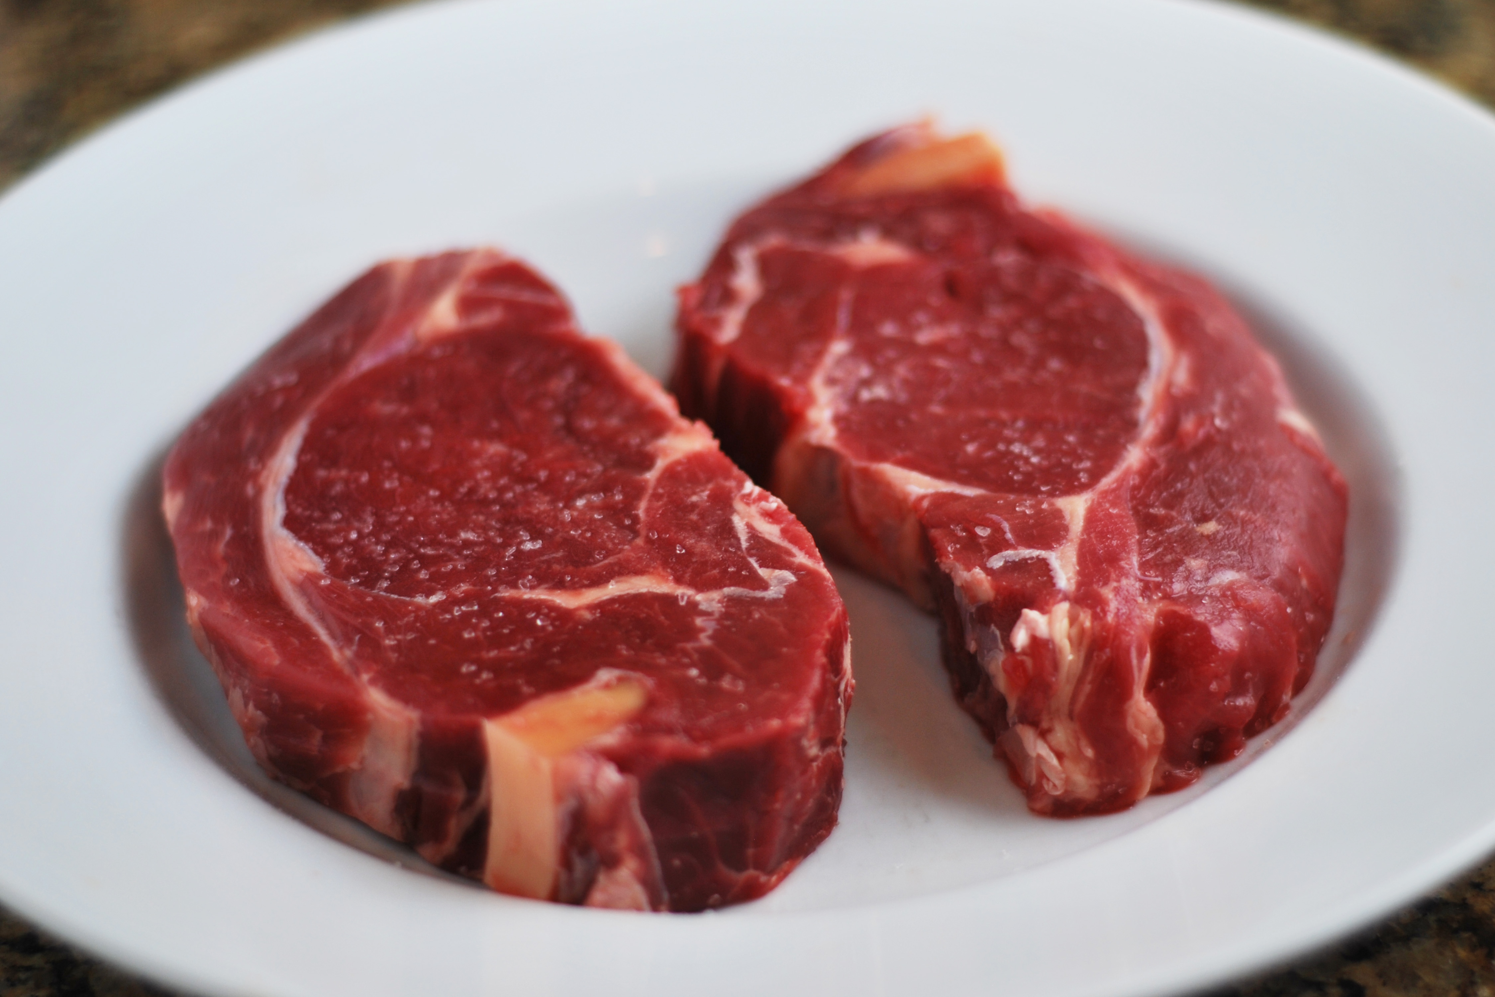
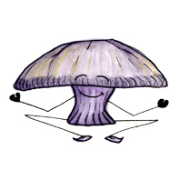
Serving Size for 1500 calories/day plan
Total Calories in this Meal 527
Preparation Key: *Kids **Parents
Beef Bites
INGREDIENTS
Sirloin Beef- 3 1/2 oz Garlic clove- 1
Fettuccine- 7/8 oz Rosemary- 1 tsp
Beef Bouillon powder- ¼ tsp Pepper- 1 tsp
Tomato paste- 2 tsp Vegetable cooking spray- 1
Mushrooms, sliced- ½ cup Yellow squash- 1 cup
Pearl Onions- ¼ cup Dinner salad- w/ dressing- 1
Carrot- ½ Whole wheat crackers- 4
All purpose flour- 1 tsp
PREPARATION
*Cook Fettuccine noodles according to package instructions.
**If using pearl onions (as recommended), steam until tender.
*Dissolve beef bouillon powder in ¼ cup hot water in a microwave safe covered bowl. Thoroughly mix in tomato paste, and sift (to prevent lumping) in flour while bouillon is still warm.
**Remove any remaining fat from beef and cut beef into 1” cubes.
**Preheat oven broiler.
*Add to bouillon mixture the mushrooms, pearl onions, and carrots and mix well. Cover and microwave on high for 5 minutes. Stir in 1 minced garlic clove, 1/8 tsp rosemary, 1/8 tsp pepper. Return to microwave, turning dish 90 degrees from its original placement, for an additional 2 minutes on high or until thoroughly heated.
**Treat broiler pan with vegetable cooking spray, arrange beef cubes on pan, and broil for 3 minutes. Turn meat over and broil for an additional 3 minutes or until desired taste.
*Arrange beef over noodles and cover with beef sauce. Serve with yellow squash, dinner salad, and crackers.
Did you know that beef is a great source of your daily protein? It provides 25 grams per 3 oz serving. It is also a good source of iron! 15% of your daily value!
Copyright ©2015 Fit4Kidz.us |All Rights Reserved | www.fit4kidz.us

