Slide 1
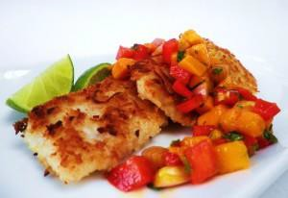
Serving Size for 1500 calories/day plan Total Calories in this Meal: 514
Preparation Key: *Kids **Parents
Baked Tilapia with Mango Salsa
INGREDIENTS
4 oz Tilapia
1/3 cup Pineapple Chunks 1/4 Mango
2 tablespoons Salsa
4 tablespoons Spanish Rice
PREPARATION
**Prepare rice as package suggests. Preheat oven to 450˚F.
*Mix pineapples, mango, and salsa.
*Place tilapia fillet in a lightly oiled pan.
*Pour 3 tablespoons or mango mixture over fillet.
*Set remaining mango mixture aside.
**Bake fillet in an oven for 15 minutes or until fillet flakes with a fork.
*Place fillet on a plate and pour remaining fillet mixture over the fillet.
Fish is an important part of your diet! If you eat two servings per week, your heart will be healthier. Also, fish provides essential nutrients and healthy fats.
Tilapia tastes delicious whether it is baked or grilled.
Copyright ©2015 Fit4Kidz.us |All Rights Reserved | www.fit4kidz.us

