Slide 1
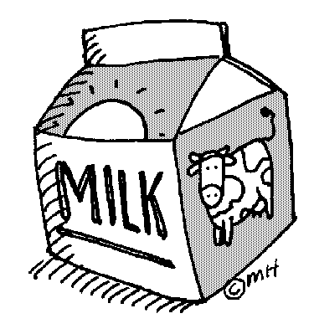
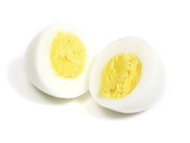
Serving size for 1500 calorie/day diet
Calories in this meal: 302
Preparation Key: *kids can help **parents
Mixed Up Strawberry Breakfast
INGREDIENTS
Strawberries- 1 cup Grapes- 2/3 cup
Skim milk- 1/3 cup Egg, hard boiled- 1
Low-fat plain yogurt- 2 Tbl
Instant Breakfast Mix- ½
Honey- ½ Tbl
PREPARATION
*Blend first five ingredients in blender until smooth. Best if consumed immediately.
*Serve with a hard boiled egg and grapes.
Strawberries are a good source of vitamin C and the skim milk and yogurt in this smoothie are good sources of calcium and protein!
Did you know that around the world there are over 8000 varieties of grapes?
Copyright ©2015 Fit4Kidz.us |All Rights Reserved | www.fit4kidz.us

