Slide 1
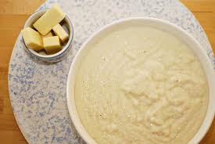
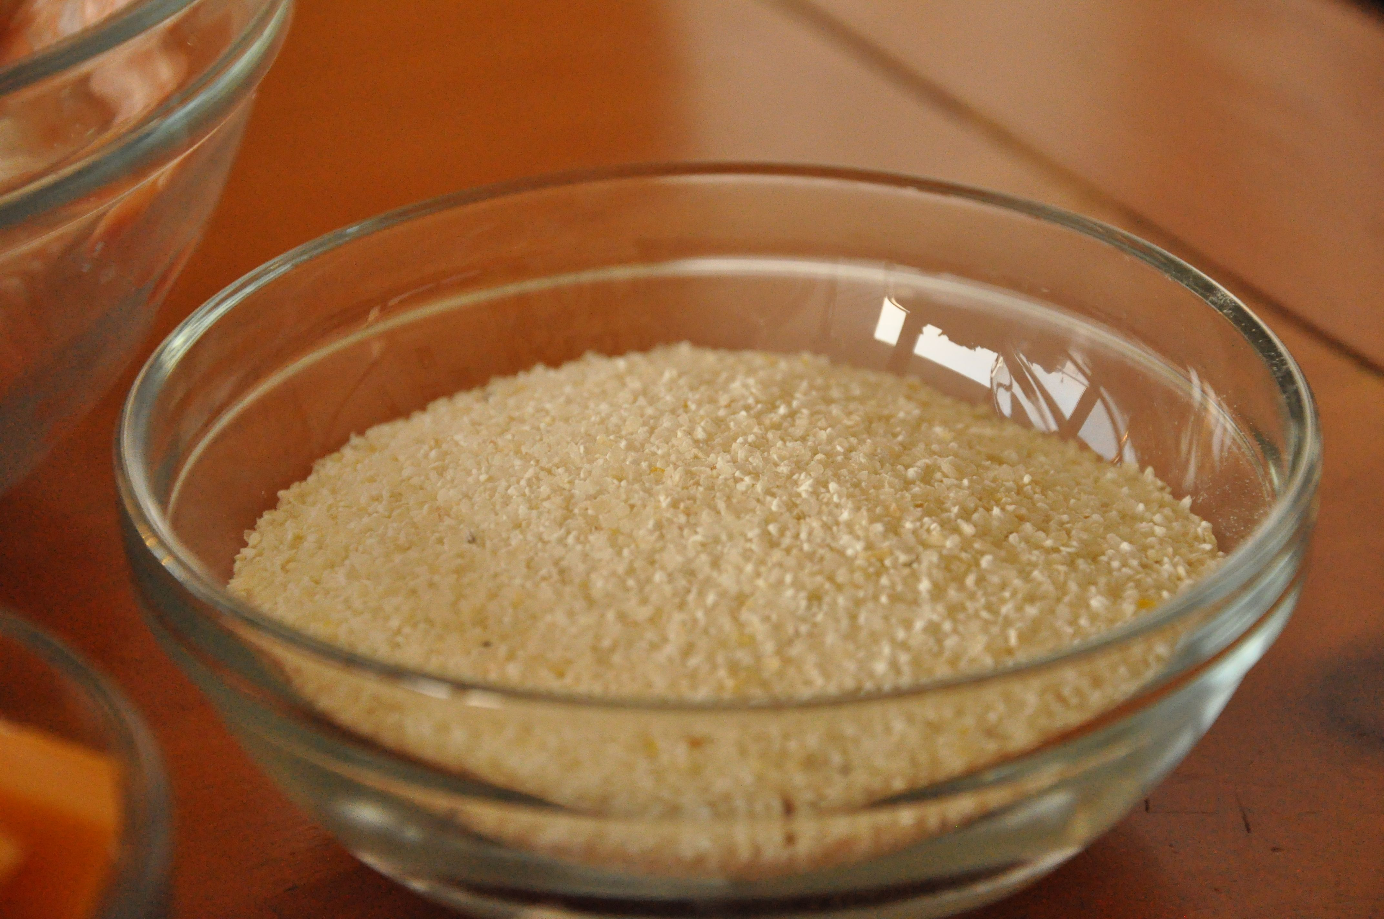
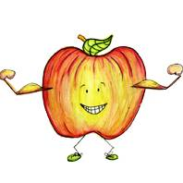
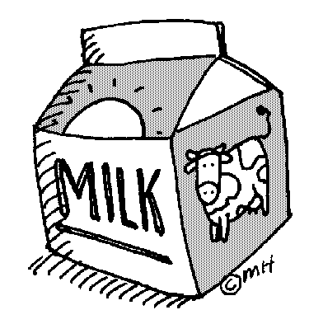
Serving size for 1500 calorie/day diet
Calories in this meal: 298
Preparation Key: *Kids Can Help **Parents
Giddy 4 Grits!
INGREDIENTS
Grits (package)-1
Skim milk – 1 cup
Light Spread – 2 Tsp
Fruit or Juice – 1 serving
Light Cranberry juice – ½ cup
PREPARATION
*Find a microwaveable bowl and pour in the milk and the contents of the package of grits
*Follow the directions on the packet for heating instructions
*Mix with spread of choice and serve with fruit and light juice
Enjoy!
Making a bowl of grits with milk is a great way to get a serving of dairy! The milk you use can count towards the recommended daily amounts from the dairy group that you should have. In addition making your grits with milk can provide you with Calcium needed for building strong bones!
Did you know that grits were named Georgia’s official state prepared food in 2002 and there is an annual grits festival held in South Carolina in April called the World Grits Festival?
Copyright ©2015 Fit4Kidz.us |All Rights Reserved | www.fit4kidz.us

